Slide 1
Use of CHVs in optimizing follow up of clients post VMMC surgeries
A case of Rachuonyo South Sub County, Homa Bay county
Milton Koyier
Prevention Lead, Ngima Mogen Project .

Slide 2


Project Background
Since the inception of the VMMC program in Kenya, client review is conducted based on the policy of physical client review by the clinicians.
At least one Clinical review is required within 14 days for all circumcised clients.
The goal is to ascertain the healing progress of all clients who receive VMMC services, this has been key in prevention of Adverse Events occurrence.

Slide 3
Project Background Cont.
During the inception of VMMC Program in Rachuonyo South Sub County, client reviews came with logistical challenges since the project was new with limited funding to support community physical client reviews.
There was shortage of dedicated vehicles and Roving clinicians to support the clients follow up.
To upscale follow up of clients for the project, we explored the community-based strategies by engaging County CHVs. Our follow up rate Percentage before the Engagement was at 82% in the first quarter, which was below the National Follow up rate of 100%.

Slide 4
Project Objective
To increase Follow up rate of VMMC clients from 82% to 100% from October 2022 to September 2023.

Slide 5
Road map of Activities
Engagement of CHVs in each area Kasipul SC
CHVs presenting clients in various facilities and central places
Improved client follow up and monitoring
1
2
44
5
3
6
6
CHVs tracking VMMC clients in the community
Clients are reviewed within 14 days
Zero Adverse Events

Slide 6
Methodology
How did we do it?
We utilized data from involvement of CHVs in the stationed various Facilities Simbiri , Nyabola, Ongamo ,Nyangiela, Ombek, Swindon and Mangima
3 CHVs were drawn from the said facilities for sensitization. The training was mainly Focused Group Discussion on how to attain the National required Follow up Rate. We also engaged clinicians who directly reached out to clients in centralized place through the CHVs.

Slide 7
Data Collection
Data was collected through follow up forms and submitted to the Facility through clinicians tasked to review the clients.
Data analyzed descriptively through bar graphs and charts.

Slide 8
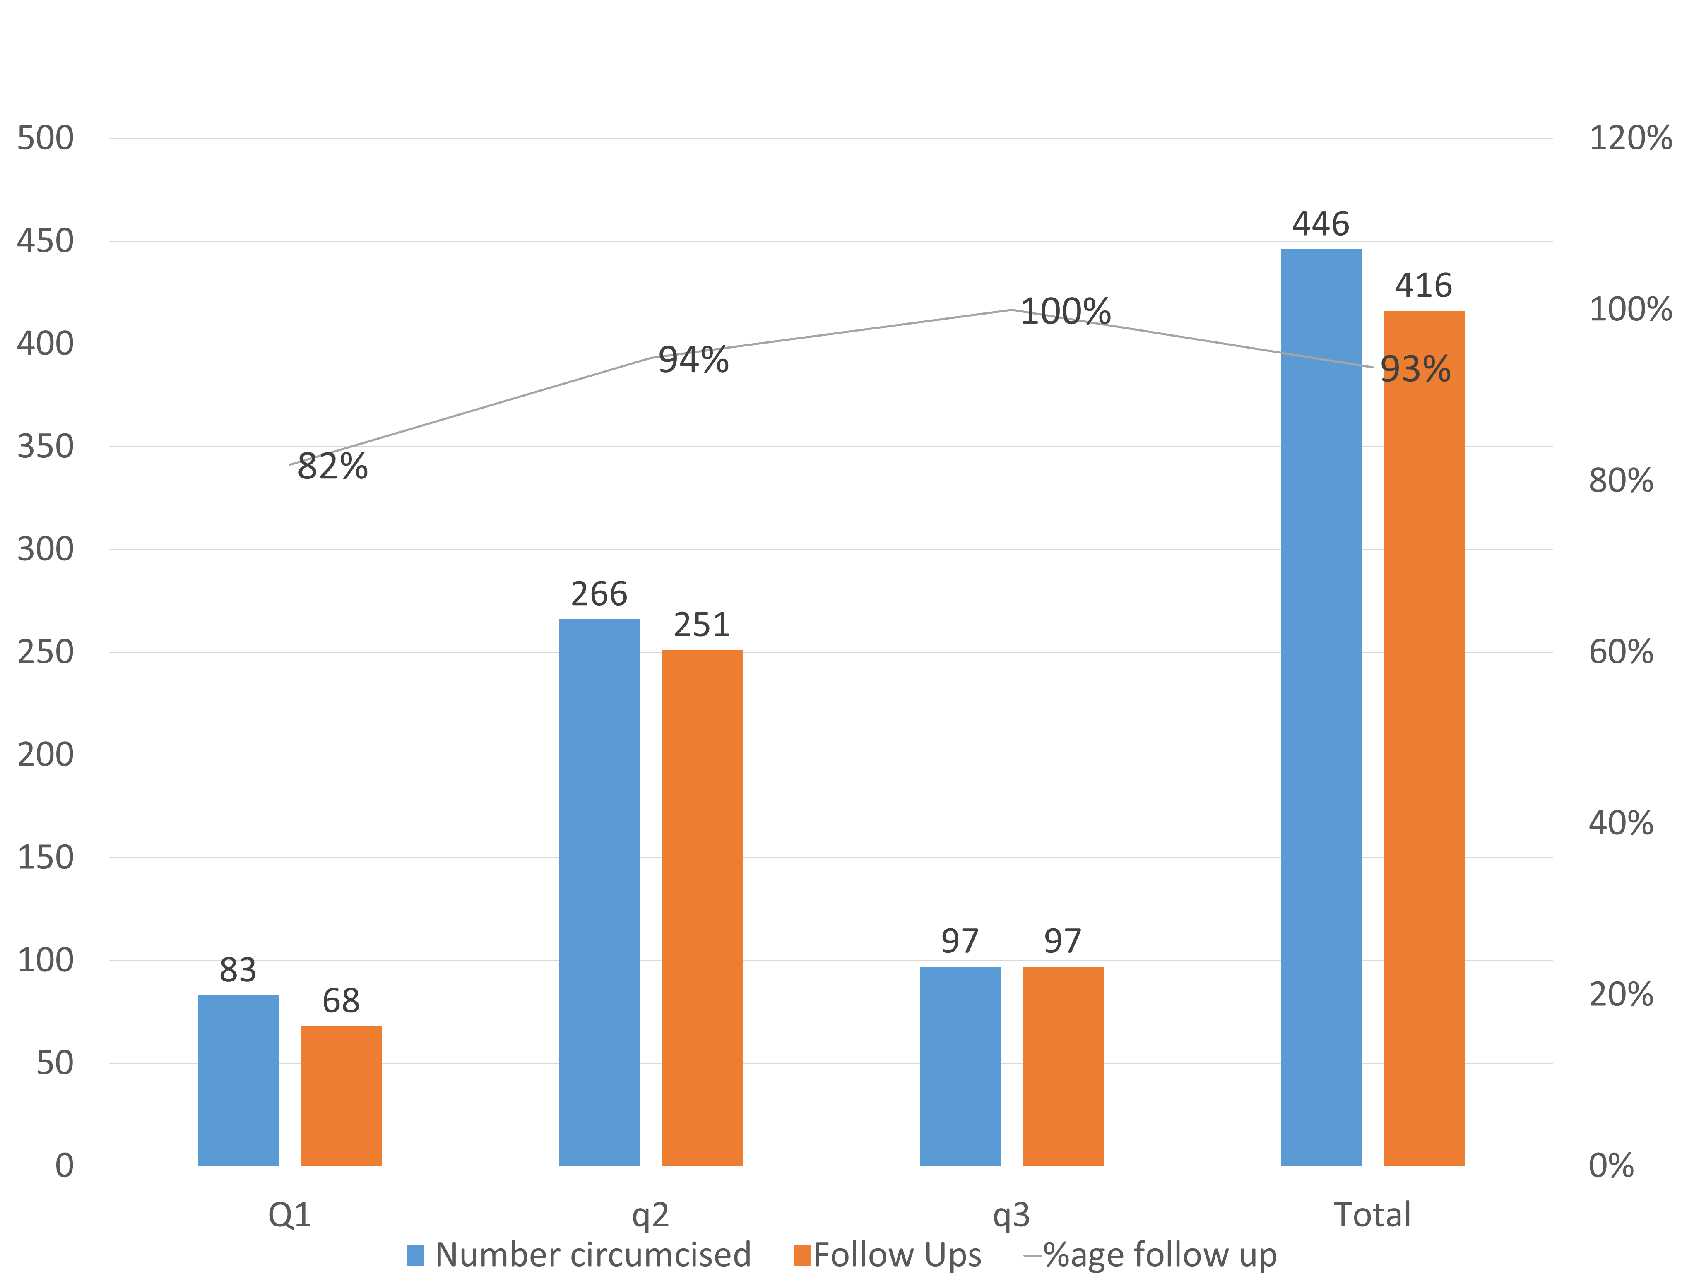
Results
VMMC Follow Up Rate

Slide 9
Lessons Learnt
CHVs play a pivotal role by providing linkages between clinicians and hard to reach clients post VMMC and educating VMMC Clients on the importance of returning to the facility for reviews.
CHVs with minimal training and education can significantly support client reviews especially for clients with no indication for clinical reviews in resource-limited settings.

Slide 10
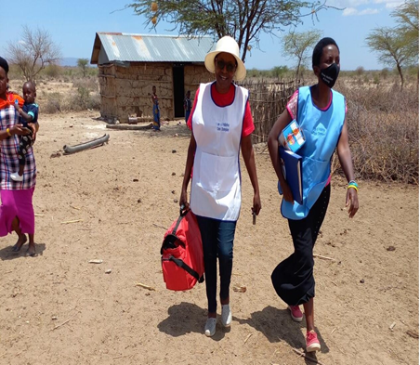
Conclusions and Recommendations
Utilization of CHVs to enhance community VMMC Follow up as a strategy is a great step towards improving follow up rate (95%) and prevention of occurring adverse events post Male circumcision
Image of CHVs in community outreaches and follow up

Slide 11
THANK YOU
Any Question please?

